Slide 1
Relationship Between Snow Extent and Mid-Latitude Cyclone Centers From NARR Objectively Derived Storm Position and Snow Cover
Matthew Rydzik
Advisor: Ankur Desai
Department of Atmospheric and Oceanic Sciences
University of Wisconsin - Madison
AOS Department Seminar
April 11th, 2012

Slide 2
Outline
Introduction
Data / Methods
Snow Cover Extent Algorithm
MLC Identification and Tracking
Results / Discussion
Relationship between snow cover and MLCs
Low-level Baroclinicity
Conclusions
Role in poleward shift of storm tracks?

Slide 3
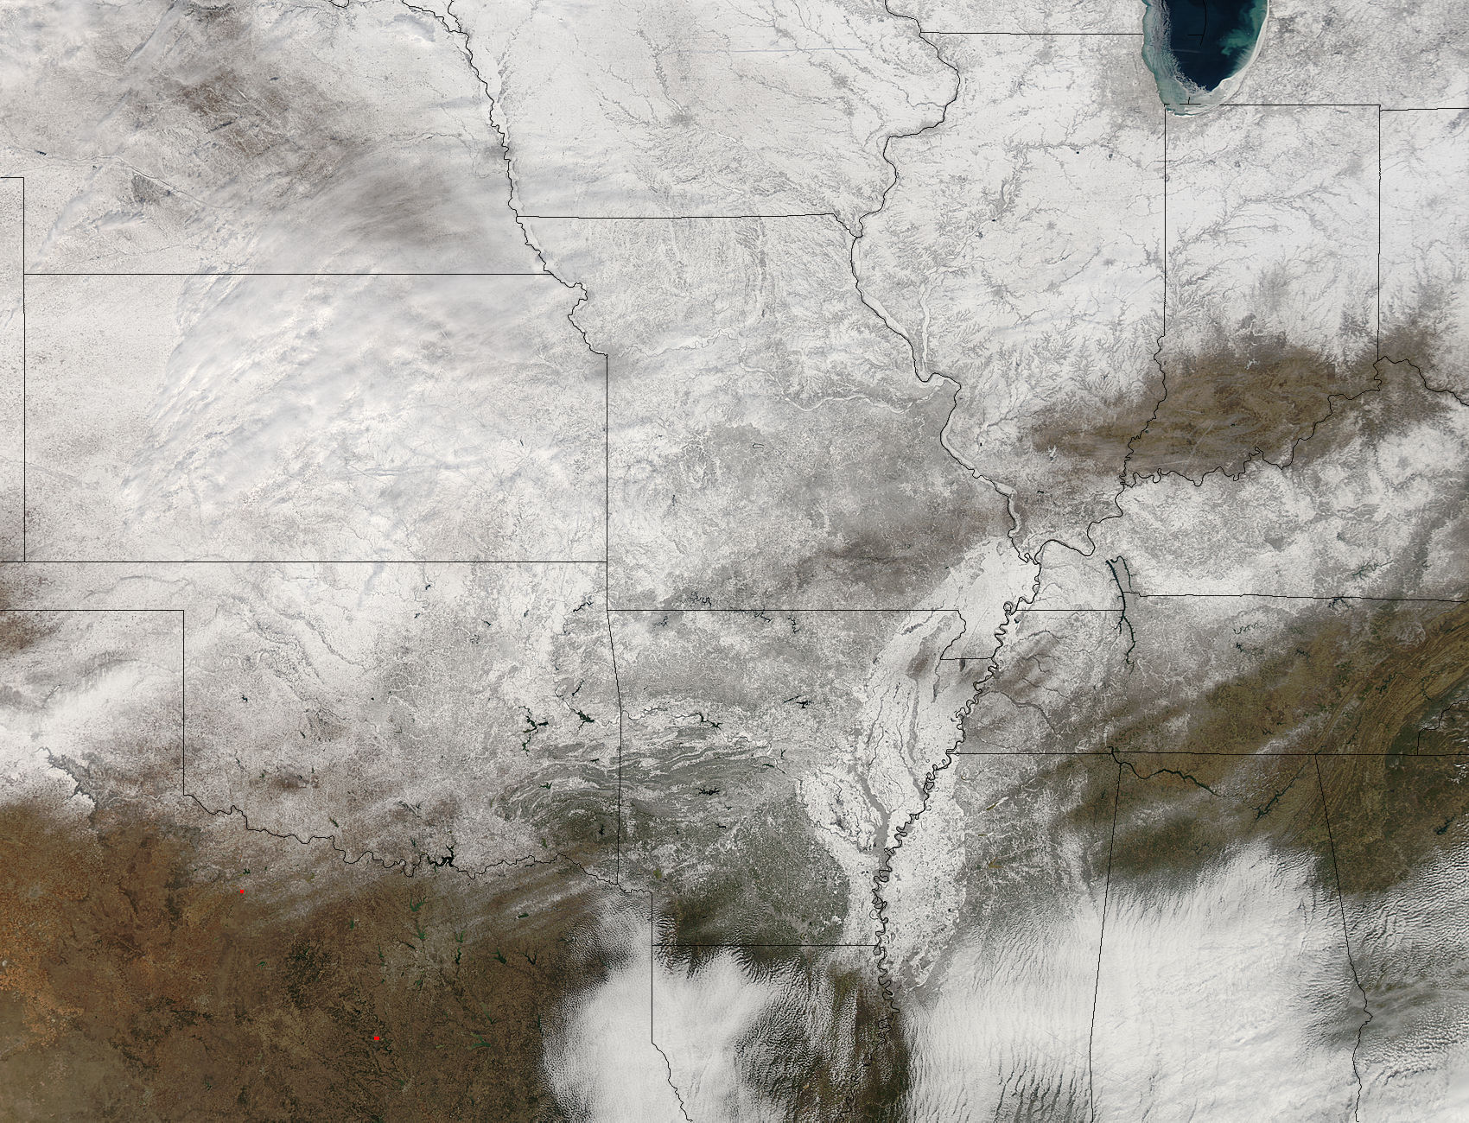
Snow Cover Impacts
High albedo reflects more solar radiation
Cooler temperature
Infrared Blackbody
Cooler temperature
at night
Insulation
Low thermal
conductivity
MODIS - 02/10/2011 - 19:25 UTC

Slide 4
Why do we care?
“General features include a poleward shift in storm track location, increased storm intensity, but a decrease in total storm numbers” - IPCC (2007)
“The baroclinic zone is a lot of times the place where storms will track. Repeated storm tracks will continue to move the snow cover slightly southward.” - Eric Sorensen - WREX

Slide 5
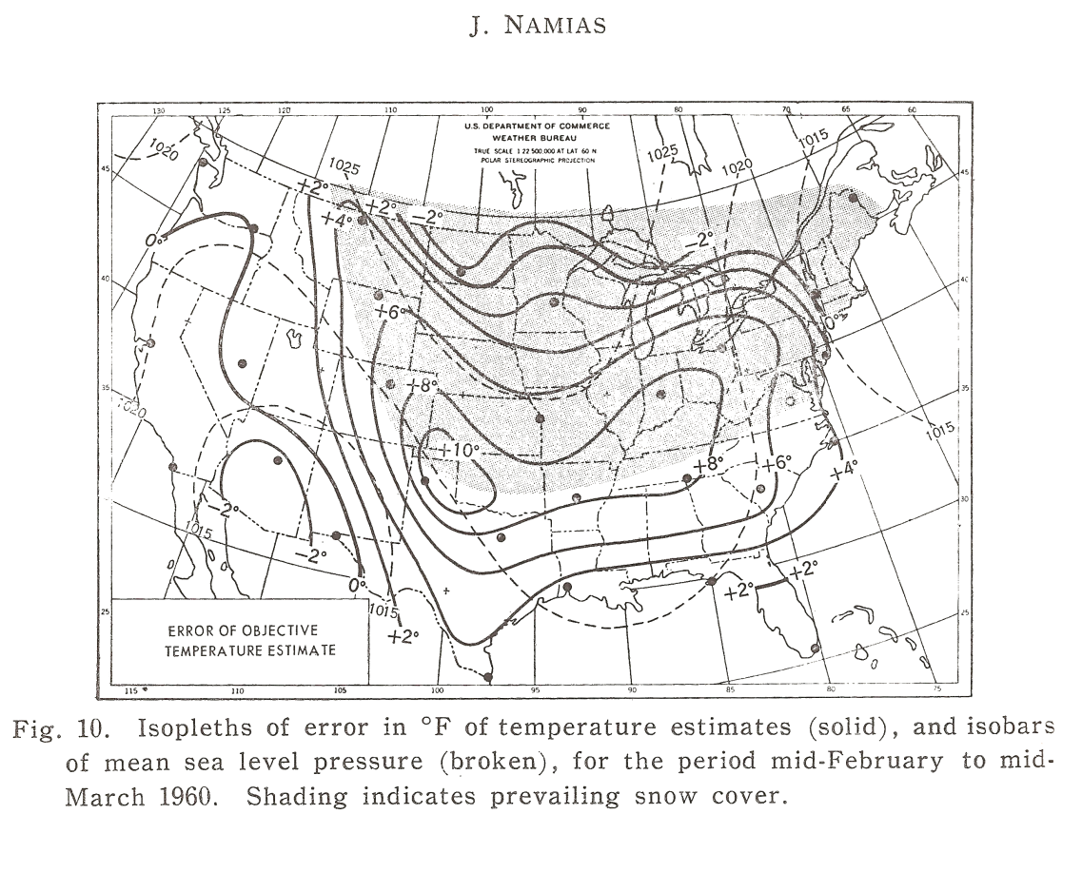
Snow Cover Influence on MLCs
Namias (1962) postulated feedback cycle
General circulation favored southern snow extent
Air masses cooled by anomalous snow cover
Increased low-level
temperature contrast
MLCs feed off of enhanced
low-level baroclinicity
5. MLCs aided in injecting
future air masses further
southward

Slide 6
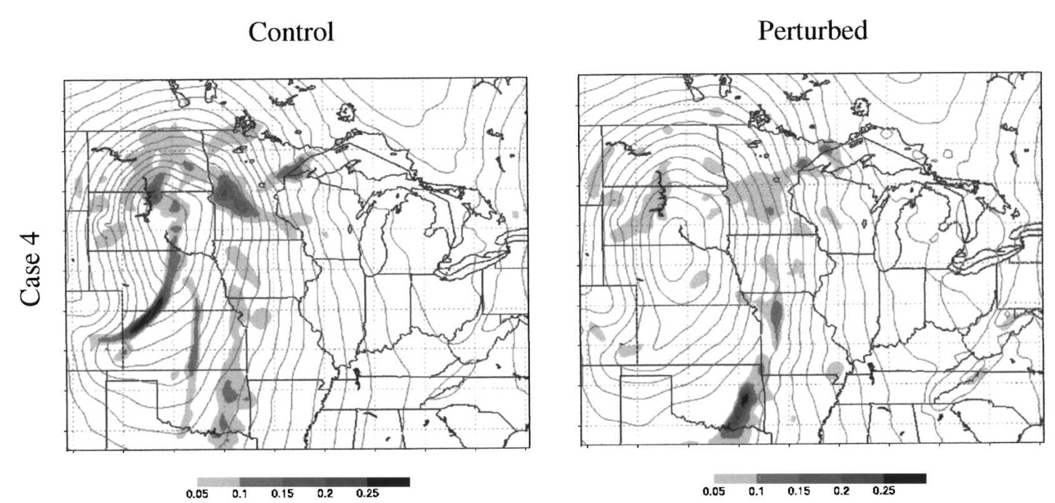
Snow Cover Influence on MLCs
Elguindi et al. (2005) ran model simulations of MLC with modified snow cover
Control versus Expansive Snow Cover
No significant change in MLC trajectories
MLCs weakened with increased snow cover

Slide 7
Outline
Introduction
Data / Methods
Snow Cover Extent Algorithm
MLC Identification and Tracking
Results / Discussion
Relationship between snow cover and MLCs
Low-level Baroclinicity
Conclusions
Role in northward shift of storm tracks?

Slide 8
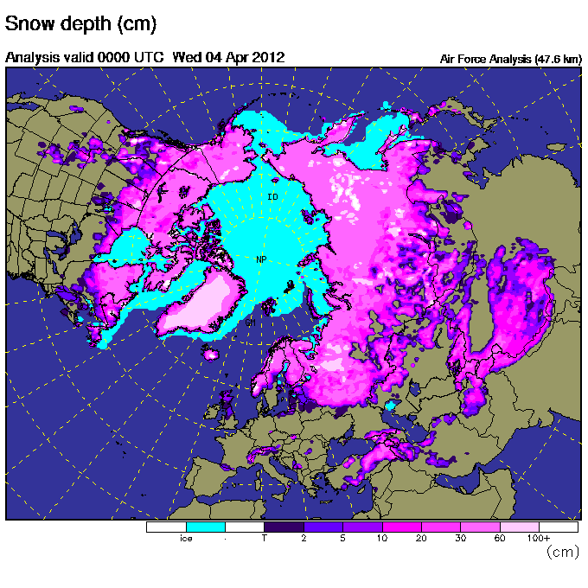
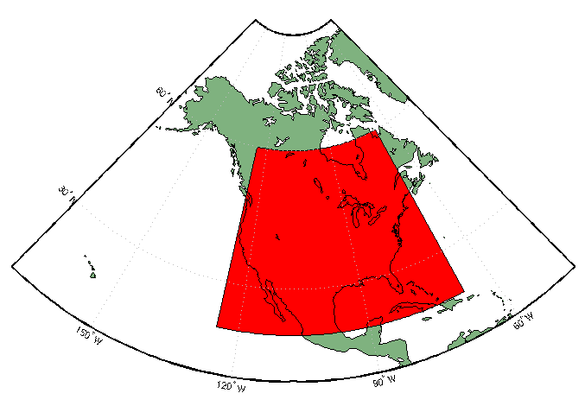
NARR
Regional reanalysis at 32 km grid spacing
Snow water equivalent updated at 0000 UTC using SNODEP (Air Force Weather Agency)
Station Observations
Satellite Retrievals
Manual Interpretation

Slide 9
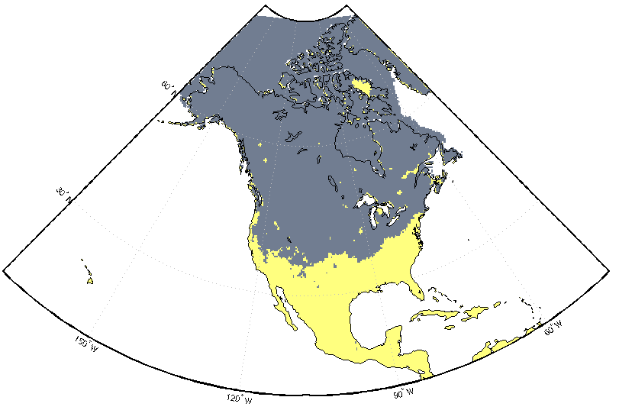
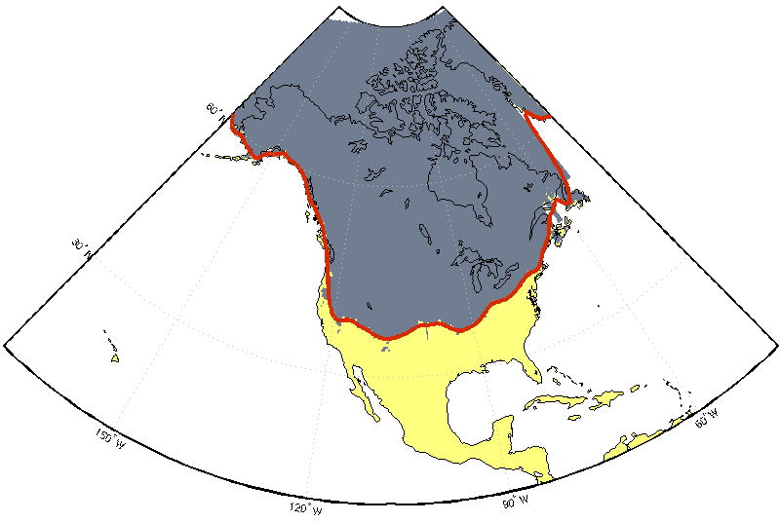
Snow Extent
Gaps filled in 0000 UTC NARR categorical snow presence
Linearly interpolated to 0.25° grid
For each longitude, find 2.5° of consecutive snow cover from south to north
Smooth snow extent with 2.5° filter

Slide 10
SNODAS
Modeling and data assimilation framework
1 hr temporal and 1 km grid spacing
Incorporates:
Quality controlled and downscaled numerical weather prediction output
Snow pack model
Data assimilation scheme
Full details in Barrett (2003)

Slide 11
NARR - SNODAS

Slide 12
NARR - SNODAS

Slide 13
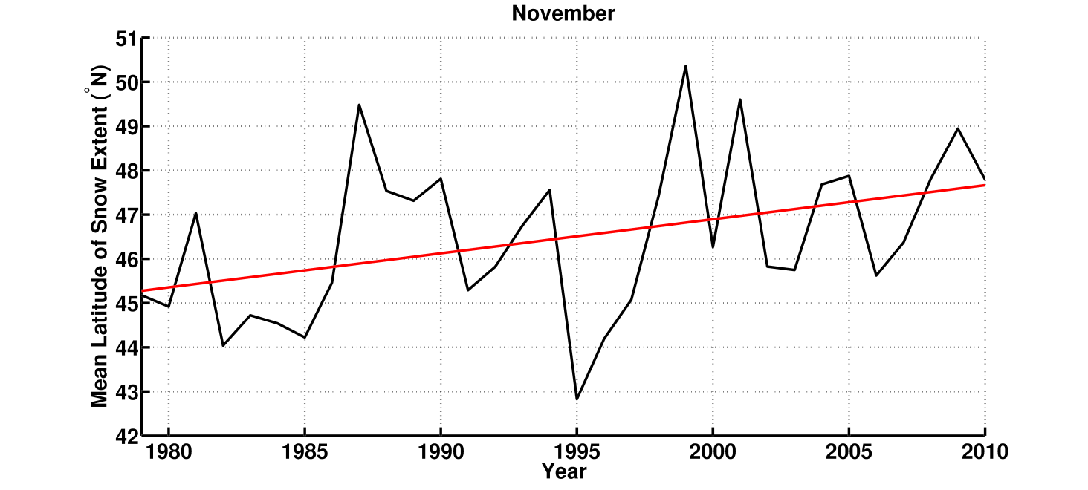
Snow Cover Trends

Slide 14
MLC Identification
Pressure minima located at fine (0.25°) and coarse (2.5°) resolution
Coarse minimum moved to nearest fine minimum

Slide 15
MLC Tracking
Nearest centers within 400 km are linked at three hour time steps
Center must move in six hours
Center may not backtrack
Center allowed to disappear for one time step

Slide 16
Snow Cover & MLC Video

Slide 17
Outline
Introduction
Data / Methods
Snow Cover Extent Algorithm
MLC Identification and Tracking
Results / Discussion
Relationship between snow cover and MLCs
Low-level Baroclinicity
Conclusions
Role in northward shift of storm tracks?

Slide 18
MLC Distance from Snow Extent
Snow
No Snow

Slide 19
MLC Distance from Snow Extent
Snow
No Snow

Slide 20
MLC Distance from Snow Extent
Snow
No Snow

Slide 21
Why a Bimodal January?
Likely caused by Alberta clippers
Occur roughly 600-800 km north of typical January snow cover extent
Most common in January
Average Alberta clipper track from Thomas and Martin (2007)

Slide 22
Robustness
Create distributions from shuffled snow cover
Use the other 31 years of snow cover from the same day
Subtract new distribution from original
Sum the differences
Assume that shuffling creates random noise that will cancel when summed
Regions of coherent peaks are assumed to be significant

Slide 23
Robustness
Snow
No Snow

Slide 24
Robustness
Snow
No Snow

Slide 25
Robustness
Snow
No Snow

Slide 26
Lagged Relationships
A relationship between MLCs and snow cover is expected
During the winter, MLCs tend to deposit snow on their northern side
If pre-existing snow cover is driving the relationship, then we expect little change in the distributions

Slide 27
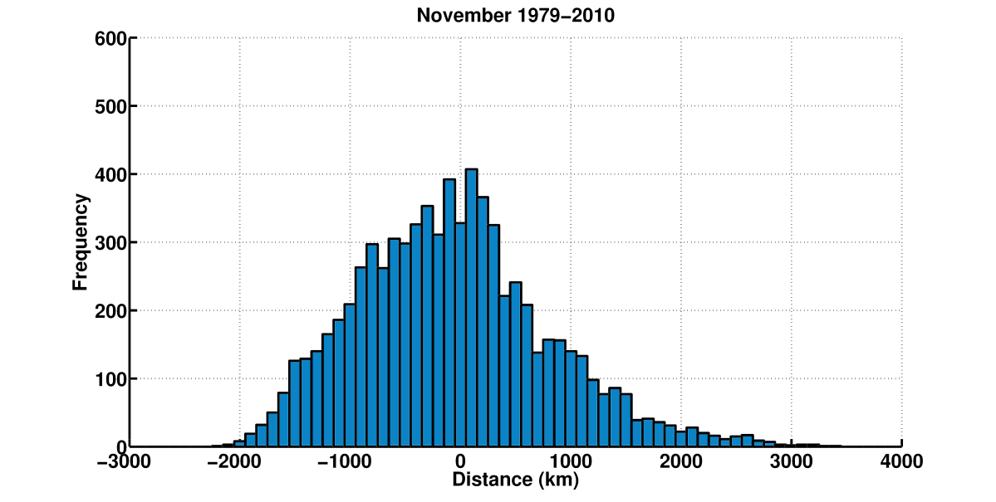
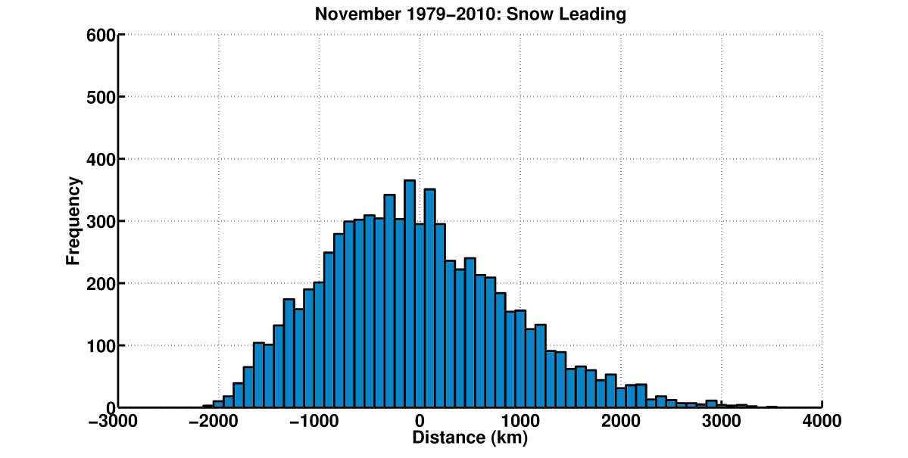
Lagged Relationship Snow Leading
Snow
No Snow

Slide 28
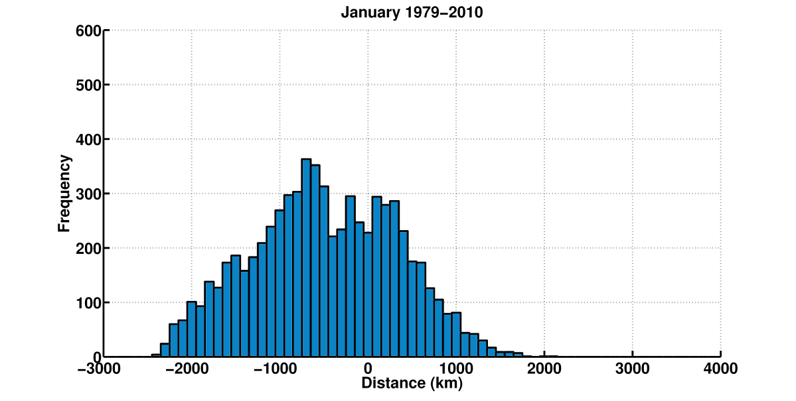
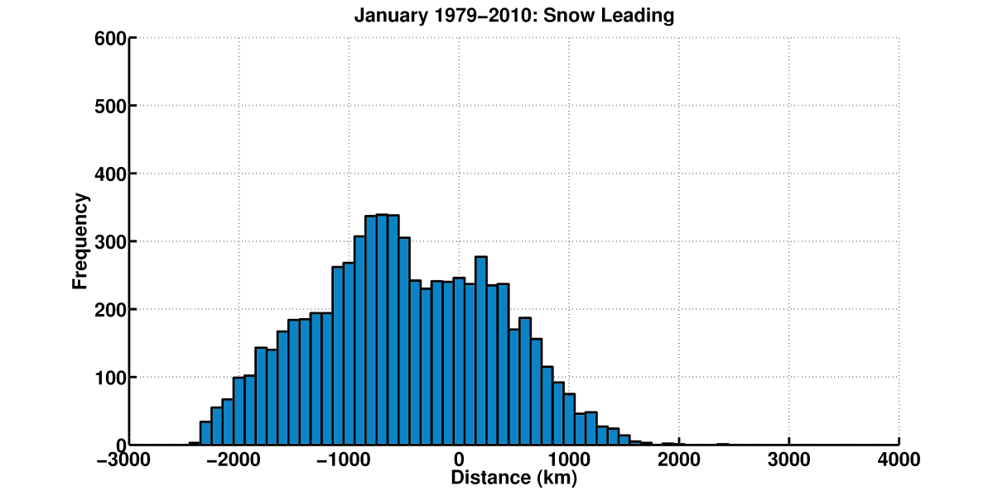
Lagged Relationship Snow Leading
Snow
No Snow

Slide 29
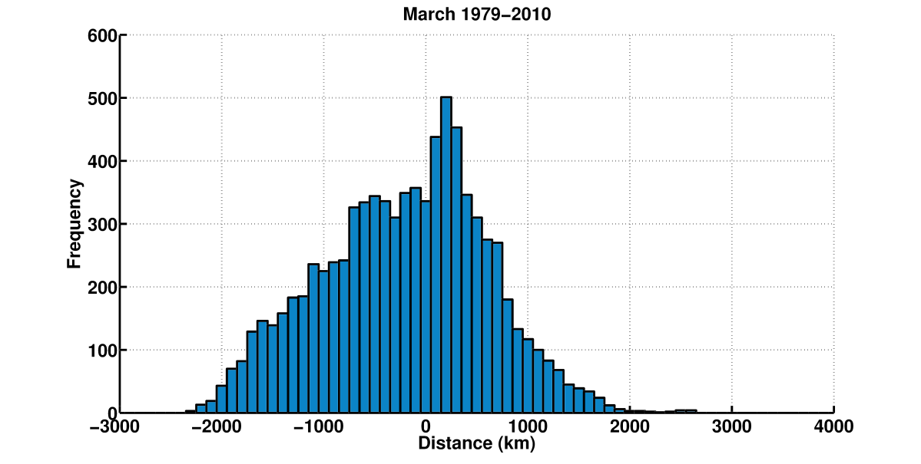
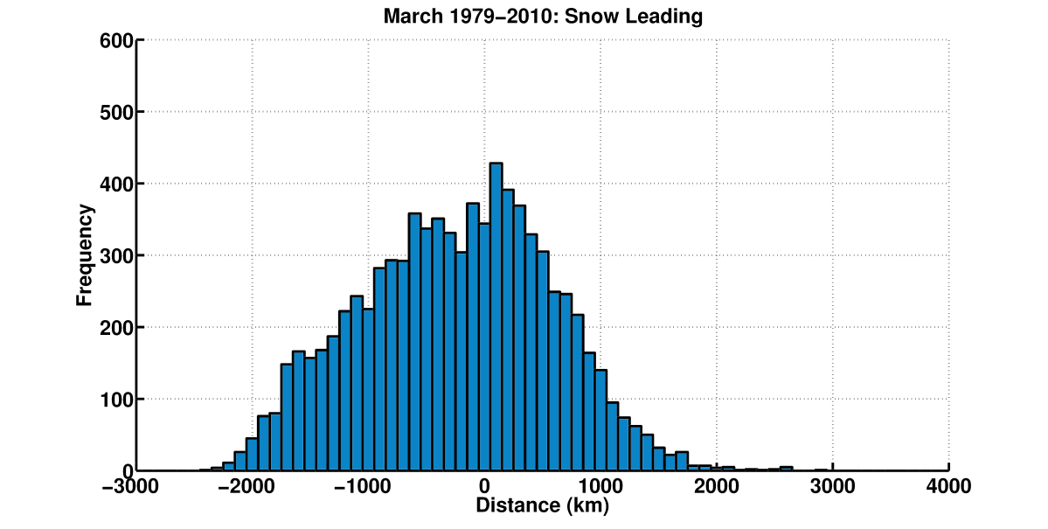
Lagged Relationship Snow Leading
Snow
No Snow

Slide 30
Lagged Relationships
Little change between no lag and snow leading by two days
Inherent lag for some MLC centers because of NARR snow water equivalent update time
If the MLC is leading the snow cover, then we expect a shift in the distributions to the left

Slide 31
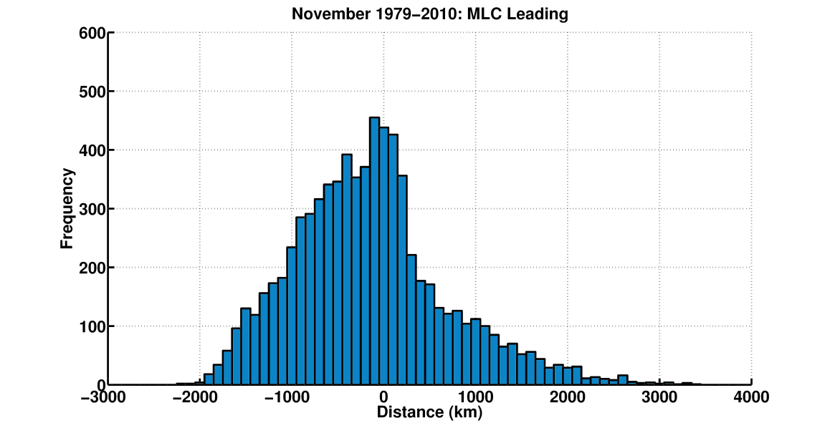
Lagged Relationship MLC Leading
Snow
No Snow

Slide 32
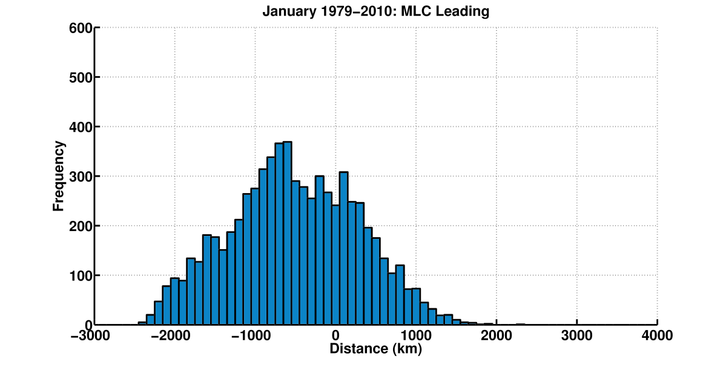
Lagged Relationship MLC Leading
Snow
No Snow

Slide 33
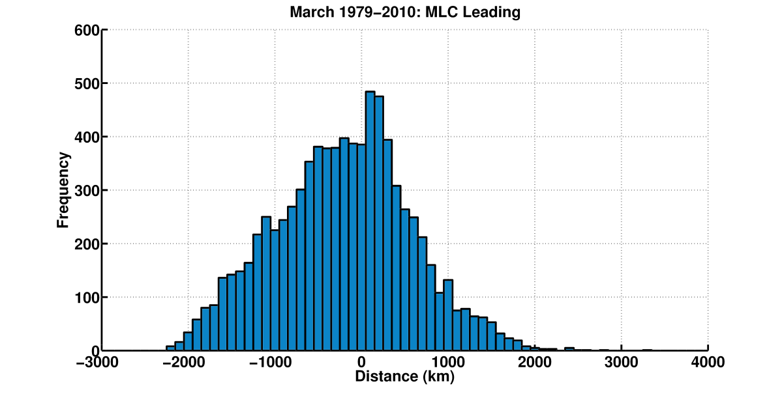
Lagged Relationship MLC Leading
Snow
No Snow

Slide 34
Why is there a relationship?
Albedo gradient
Temperature gradient
Increased low-level baroclinicity
Area more favorable for MLC
Radiation gradient

Slide 35
Low-level Baroclinicity
P - 6ΔP
P
Ground
(based off of Lindzen and Farrell, 1980)

Slide 36
Low-level Baroclinicity

Slide 37
Low-level Baroclinicity
Snow
No Snow

Slide 38
Low-level Baroclinicity
Snow
No Snow

Slide 39
Low-level Baroclinicity
Snow
No Snow

Slide 40
Snow Extent Albedo

Slide 41
Snow Extent Temperature

Slide 42
Snow Extent Sensible Heat Flux

Slide 43
Snow Extent Latent Heat Flux

Slide 44
Outline
Introduction
Data / Methods
Snow Cover Extent Algorithm
MLC Identification and Tracking
Results / Discussion
Relationship between snow cover and MLCs
Low-level Baroclinicity
Conclusions
Role in poleward shift of storm tracks?

Slide 45
Poleward Shift
Snow cover extent is expected to decrease with ACC (Brown and Mote, 2009)
Thus, our relationship suggests snow cover extent will lead MLCs poleward over continents

Slide 46
Poleward Shift
Observed and forecast poleward shift in storm tracks from ACC, mainly in the North Atlantic and North Pacific (IPCC, 2007;Jiang and Perrie, 2007)
Increased baroclinicity off the east coast of continents important to oceanic storm track locations (Hoskins and Valdes, 1990)

Slide 47
Poleward Shift
Ross and Walsh (1986) found that enhanced baroclinicity near coastal boundaries due to increased snow cover is important to MLC trajectories
The relationship suggests that continental snow cover may play a role in oceanic storm tracks shifting poleward

Slide 48
Future Work
Why is it the region 50-350 km south of the snow extent?
Why is MLC frequency confined to a narrow region while low-level baroclinicity has a broad structure?
Methods
Idealized model
Case studies with small snow extent perturbations

Slide 49
Take Home Messages
Enhanced frequency of MLCs in a region 50-350km south of snow extent
Stronger relationship during the spring
Driven by low-level baroclinicity
May play a role in the poleward shift of storm tracks with ACC

Slide 50
Acknowledgements
Advisor – Ankur Desai
Readers – Dan Vimont and Jon Martin
Labmates
Fellow Graduate Students
Mallie Toth for support and proofreading

